Slide 1

SOFTWARE ENGINEERING WS 24/25 ML 24/25–03 Implement Anomaly Detection Sample Presented by : Team Synergy
Muhammad Talha Saleem 1502910 talha.saleem@stud.fra-uas.de | Samra Arif 1565456 samra.arif@stud.fra-uas.de | Waqas Ahmed 1569061 waqas.ahmed@stud.fra-uas.de
Project Implementation: https://github.com/Muhammad-Talha-S/synergy-neocortex-ad
Presented to : Damir Dobric & Andreas Pech

Slide 2
Agenda
Objective
Introduction
Data Collection and Preprocessing
Algorithm Design
Anomaly Detection Logic
Processing Elements
Project Analysis and Code Review
Line Charts for Sample Anomaly Detection
Conclusion

Slide 3
Objective
Introduction
Anomaly detection is the process of identifying data points that do not conform to expected patterns.
Using Neocortex API, we train models on normal sequences and detect deviations.
Application areas: Power consumption prediction, fraud detection, sensor data monitoring, etc.
The objective of this experiment is to design and implement an Anomaly Detection system using the NEOCORTEX API framework. The system will learn multiple sequences representing patterns of normal behavior and later predict the next values in new sequences. If the predicted values deviate beyond a defined tolerance from the actual observed values, the system will detect an anomaly.
3

Slide 4
Data Collection and Preprocessing
Train a model using multiple similar sequences representing normal behavior.
Use the trained model to predict the next value in new sequences.
Compare predicted and actual values to detect anomalies.
Log results in a CSV file and generate graphical representations.
Sequence 1: 22, 24, 26, 28, 26, 24, 26, 27, 29, 30, 32, 33, 30, 31, 34, 36, 35, 37, 38, 36, 37, 39, 40, 41, 43, 44
Sequence 2: 22, 24, 25, 27, 26, 25, 26, 27, 28, 30, 31, 33, 30, 32 , 34, 36, 37, 35, 38, 36, 37, 39, 40, 41, 43, 44
Sequence 3: 22, 24, 23, 24, 26, 24, 26, 28, 29, 30, 33, 34, 32, 31 , 34, 36, 35, 37, 38, 36, 37, 39, 40, 41, 43, 44
4

Slide 5
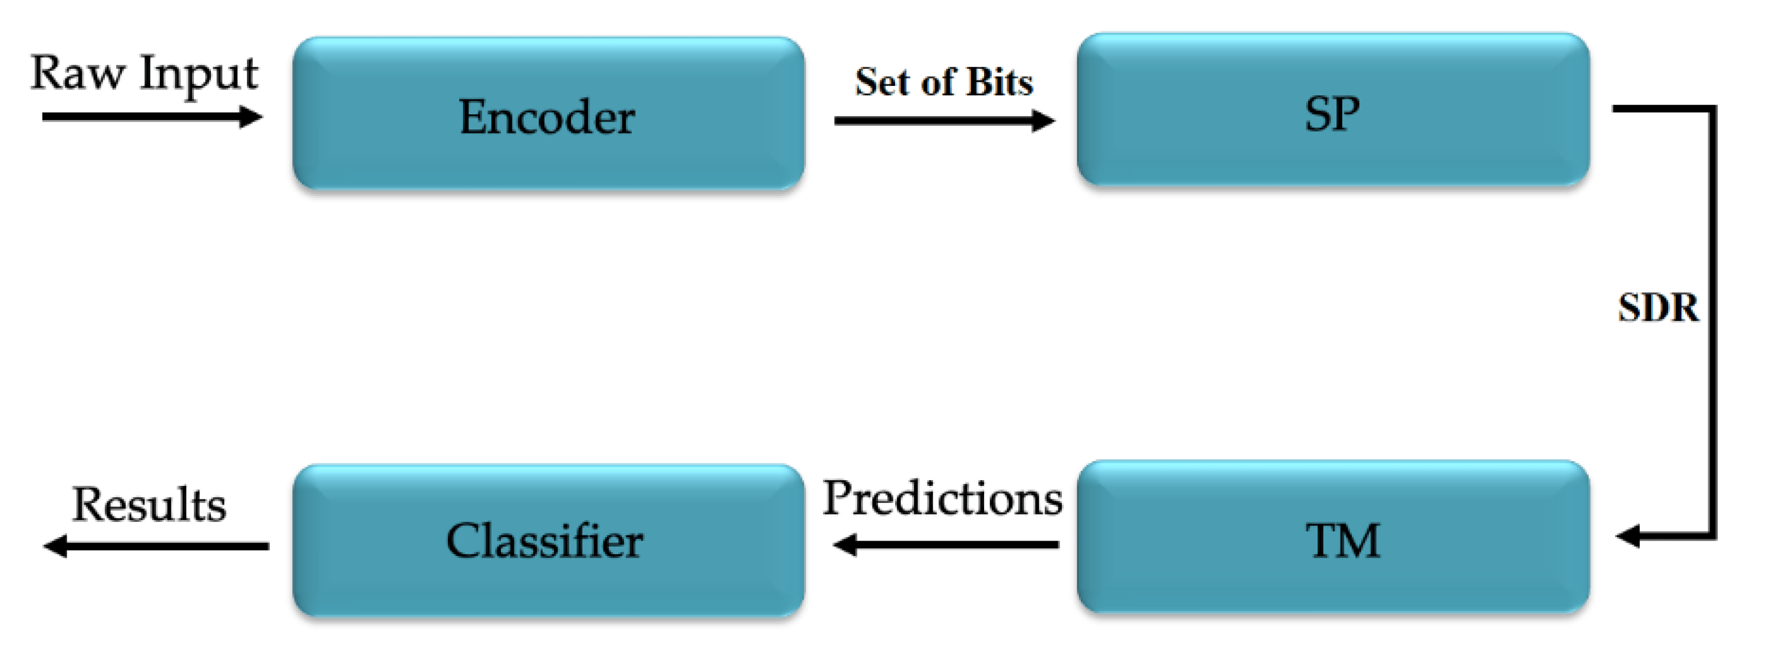
Algorithm Design
A machine learning algorithm inspired by the human brain.
Uses spatial and temporal memory for detecting anomalies.
Key advantage: Works with streaming data in real time.
Data preprocessing for HTM model training.
HTM core processing for learning sequences.
Anomaly scoring and alerting mechanisms.
Hierarchical Temporal Memory (HTM) is a machine learning algorithm that attempts to replicate the functioning of human neocortex. The HTM architecture consists of Spatial Pooler (SP) that transforms input data into Sparse Distributed Representation (SDR) and Temporal Memory (TM) which is responsible for the learning process. Precisely, the input data are fed to the encoder that converts them to binary values that is received by the SP which then generates SDR values.
5

Slide 6

Anomaly Detection Logic
Predicted value at time t is denoted as P.
Actual observed value at time t is A.
Anomaly Condition:
Where,
P: Predicted value
A: Actual value
T_{abs}​: Absolute threshold
T_{rel​}: Relative tolerance
Tolerance Value is 10%
Threshold = Relative Threshold*
*The absolute deviation threshold, determined as the minimum value from both training and inference sequence
6

Slide 7
Project Workflow
Entry Point
Program.cs
File Handler
Console Arguments Handler
CSV Handler
Multisequence Learning
CSV TO HTM Input
Anomaly Detection
Frankfurt University Of Applied Sciences, 2024/25
7

Slide 8
Project Analysis and Code Review
8

Slide 9
Processing Elements
Processing Element | Predicted Value | Actual Next Value | Anomaly Flag | Expected | Found
22 | 24 | 24 | No
24 | 26 | 23 | No
26 | 28 | 24 | No
28 | 40 | 29 | Yes | 29 | 40
24 | 26 | 26 | No
26 | 27 | 24 | No
27 |  |  |  | Skip
29 | 30 | 30 | No
30 | 32 | 33 | No
32 | 14 | 34 | Yes | 34 | 14
31 | 34 | 34 | No
34 | 36 | 36 | No
36 | 35 | 35 | No
35 | 37 | 37 | No
37 | 38 | 38 | No
38 | 50 | 36 | Yes | 36 | 50
37 |  |  |  | Skip
39 | 40 | 40 | No
40 | 41 | 41 | No
41 | 43 | 43 | No
43 | 44 | 44 | No
9

Slide 10
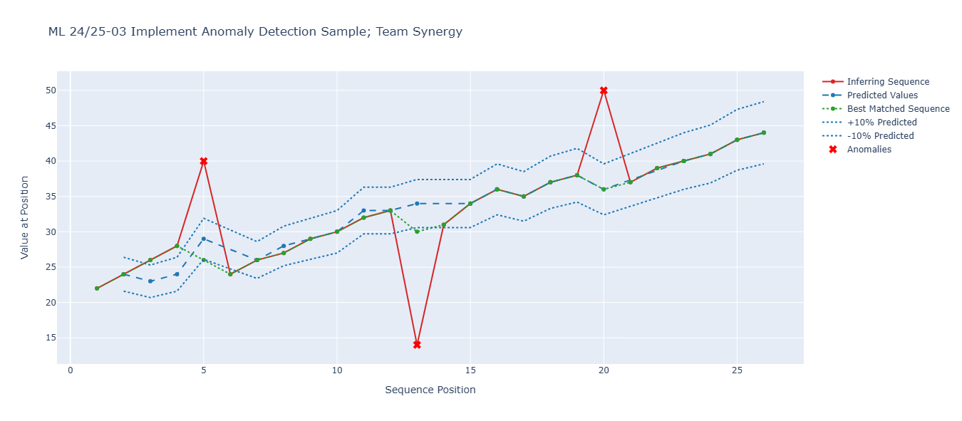
Line Charts for Sample Anomaly Detection
10

Slide 11
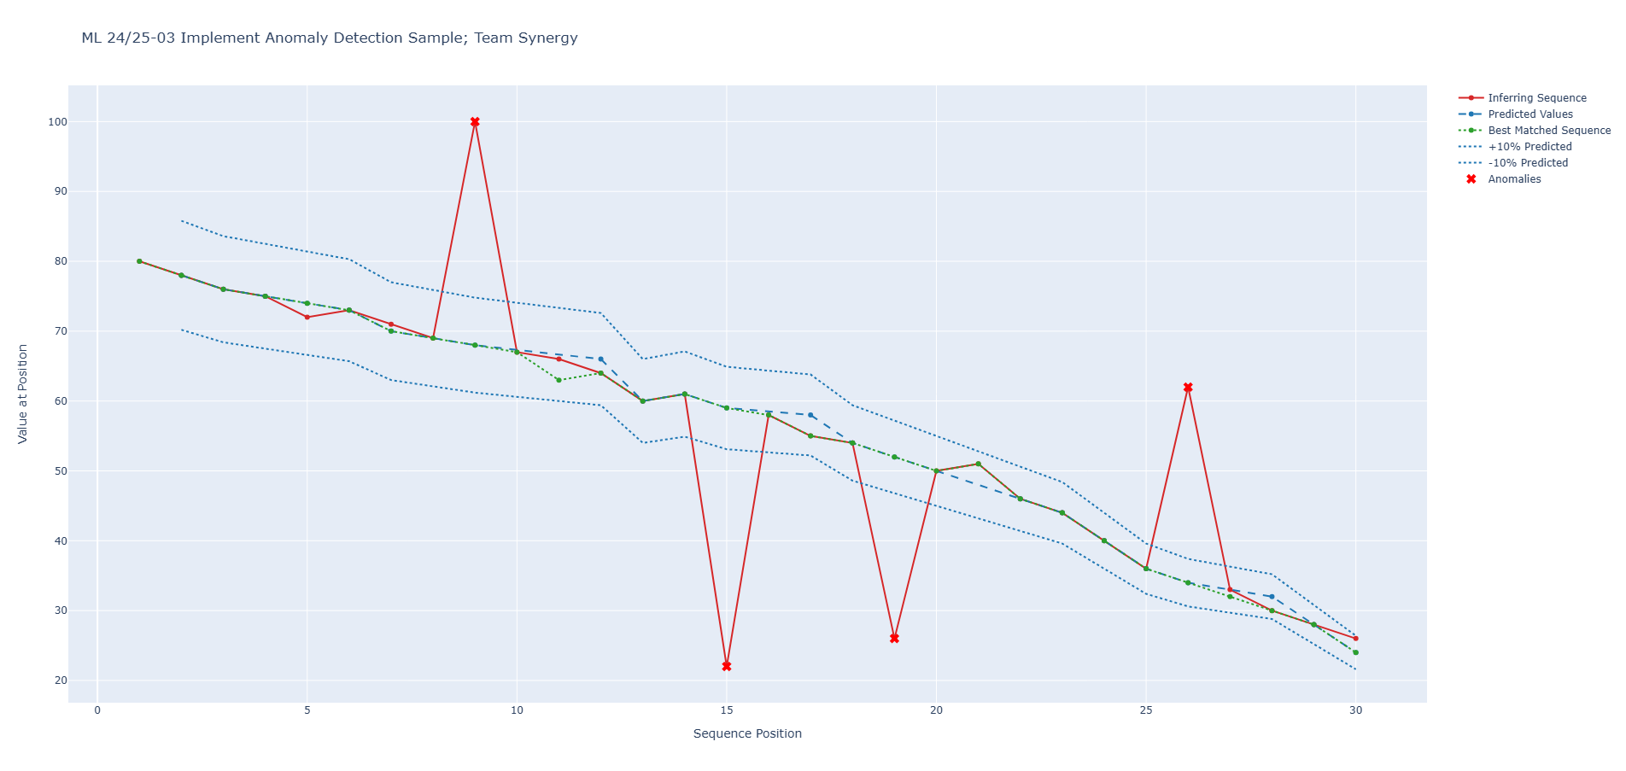
Line Charts for Sample Anomaly Detection
11

Slide 12
Conclusion
We present a working HTM implementation for temporal anomaly detection, demonstrating effective pattern learning through spatial-temporal processing. Future work will address:
Dynamic threshold adaptation
Distributed training
Streaming data support
12

Slide 13
Thank You!
13

